Slide 1
Crimson Clubs
Adam Gabriel, Max Livingston, Travis Redfield, Maclane May, Taylor Meads

Slide 2
Description Review

Slide 3
Definitions
Admin User – Club leaders, officers, faculty advisors, etc. who have more privileges for a specific club than others. Doubles as a standard user.
Standard User – A normal user with normal privileges.

Slide 4
Functional Requirements (Admin)
Add other people/Approve people
Create Events
Push Notifications
Remove People
Modify Description/Info/Tags
Add Stats (Low)

Slide 5
Functional Requirements (Normal)
Request to Join Club/Join Club
Search Clubs
Look at Personal Calendar
Leave Clubs
Look at info
Create Profile
View Event Stats/Leagues (Low)

Slide 6
Non-Functional Requirements
Login
Save to backend
Flexible UI for website and app
Profile Management (?)
Search Algorithm based on Profile/Tags (?)

Slide 7
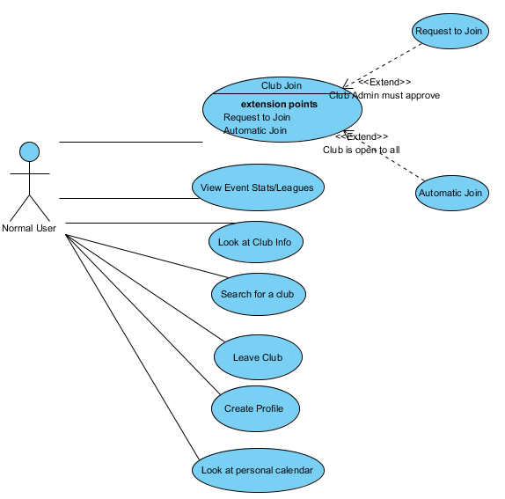
Normal User Use Case Diagram

Slide 8
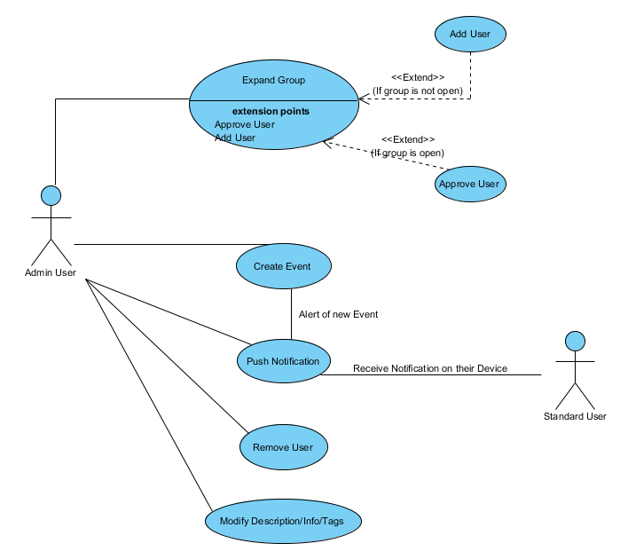
Admin User Use Case Diagram

Slide 9
Class Diagram

Slide 10
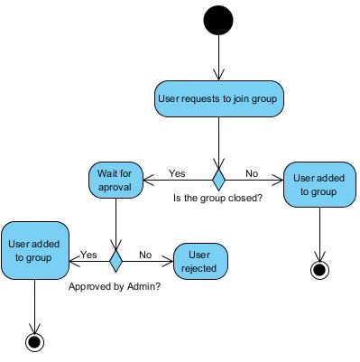
Add User

Slide 11
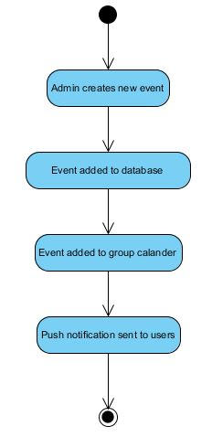
Create Event

Slide 12
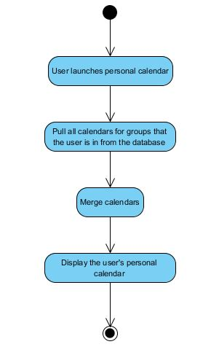
Display Personal Calendar

Slide 13
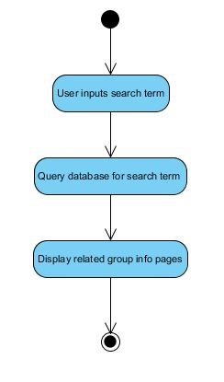
Search Clubs

Slide 14
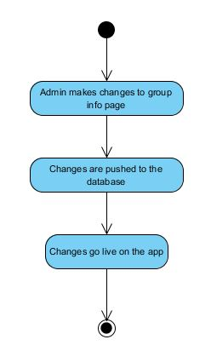
Update Club Info

Slide 15
Database Diagram

Slide 16
System Evolution

Slide 17
Potential Risks

